Slide 1


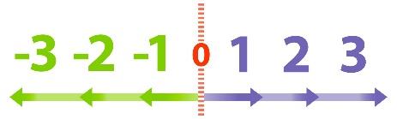
Name
Class
Tutor Group
YEAR 10 MATHEMATICS
Unit 2 Part A – Core Number Skills Place Value, Ordering Integers, Decimals and Negatives Rounding and Estimation, The 4 Operations, Order of Operations Multiplying and Dividing Decimals, Use of a Calculator
KEY VOCABULARY LIST
Integer | A whole number.
Place Value | Place value is the value of each digit in a number. It means understanding that 582 is made up of 500, 80 and 2, rather than 5, 8 and 2​.
Rounding | Rounding means making a number simpler but keeping its value close to what it was. The result is less accurate, but easier to use. Example: 73 rounded to the nearest ten is 70, because 73 is closer to 70 than to 80.
Decimal place | The position of a digit to the right of a decimal point.
Ascending | Going up, in order from smallest to largest.
Descending | Going down, in order from largest to smallest.
Negative number | A number less than zero.
Estimation | Working out an answer that is approximately (or ‘roughly’) correct. This usually involved rounding the numbers in the question to one significant figure.
Order of Operations | The order in which a multistep expression should be evaluated, for example by working out anything inside brackets first.
Notes:
ADD PAGE NUMBERS

Slide 2
CONTENTS (Unit 2 Part A) |  | Page
SUBTOPIC 1 | Place Value, Ordering integers, decimals and negatives | 3
SUBTOPIC 2a | Rounding, including rounding to decimal places | 14
SUBTOPIC 2b | Rounding to Significant Figures | 23
SUBTOPIC 3 | Estimation | 31
 | GCSE Past Paper Questions | 39
SUBTOPIC 4 | The Four Operations | 43
 | GCSE Past Paper Questions | 61
SUBTOPIC 5 | Order of Operations | 65
 | GCSE Past Paper Questions | 70
SUBTOPIC 6 | Operations with negative numbers | 71
SUBTOPIC 7 | Multiplying and dividing decimals | 75
SUBTOPIC 8 | Using a calculator | 82
 | GCSE Past Paper Questions | 87
Notes:
SPLIT UP – Check pages

Slide 3



Subtopic 1 - Place value and ordering integers and decimals
LEARNING OUTCOME: To understand how to order integers.
Objectives:
Keywords:
Integer
Place Value
Ascending
Descending
To order integers.
To order decimals
To order directed numbers
To solve problems involving ordering integers.
Definition
Characteristics
All integers which appear to the right of the 0 on a number line.
Greater than 0.
The larger integer means that the number is larger.
Examples
Positive Integers
Converting a percentage to a decimal – Examples
These numbers are all positive and all integers.
Non - Examples
$$−4$$
$$1.5$$
$$\frac{3}{4}$$
4
13
126
Ordering integers without a number line
For the following questions, list the numbers in Ascending order.
Steps | 872, 802, 870, 780, 827 | 542, 412, 585, 591, 572 | 333, 395, 299, 313, 329
Look at the place value of the leftmost digit. Write down the number with the largest place value.
If any have the same place value, look at the digit to the right and write down the number with the lowest value. Repeat until all numbers have been ordered.
Example 1 - I do…
Example 2 – We do…
Example 3 – You do…
For the following questions, list the numbers in Descending order.
Steps | 562, 56, 5620, 526, 5260 | 7312, 7321, 732, 73, 723 | 32, 372, 3372, 3732, 327
Look at the place value of the leftmost digit. Write down the number with the smallest place value.
If any have the same place value, look at the digit to the right and write down the number with the highest value. Repeat until all numbers have been ordered.
Example 4 - I do…
Example 5 – We do…
Example 6 – You do…
Notes:
PRESENTATION AND LESSON STRUCTURE????

Slide 4
Independent Practice
1. For the following questions, list the numbers in ascending order.
a) 8, 5, 9, 10, 2
b) 11, 20, 9, 15, 14, 3
c) 40, 60, 20, 30, 90, 10
d) 83, 18, 45, 37, 90, 21
e) 140, 180, 210, 70, 300
f) 605, 56, 566, 655, 506, 65, 555
g) 2000, 375, 7100, 2900, 999, 400
h) 1119, 1191, 1911 , 911, 119, 1009
2. For the following questions, list the numbers in descending order.
a) 321, 301, 312, 213, 212
b) 1031, 1021, 2021, 1030, 2020
c) 21031, 20121, 32021, 31030, 32020
d) 21531, 21331, 21351, 231151, 23151
e) 20531, 20031, 25031, 23051, 21053
f) 90531, 95031, 91530, 95130, 95101
3. Order the following temperatures from coldest to warmest: 8°C, 12°C, 9°C, 15°C, 11°C, 7°C, 2°C
Notes:
Answers

Slide 5
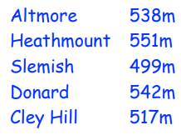
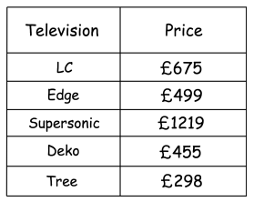
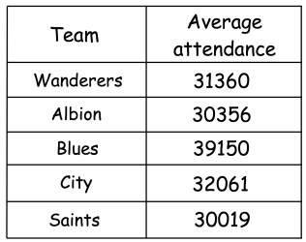
4. Shown below are the heights of five hills. | List the hills in order of size, starting with the largest.
5. The table shows the prices of five televisions | Write down the televisions in order of price. Start with the cheapest television.
6. The table below shows the average attendance for five football teams last season | Write down the teams in order of average attendance. Start with the highest
Notes:
Answers

Slide 6
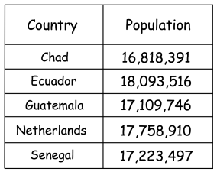
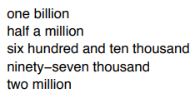
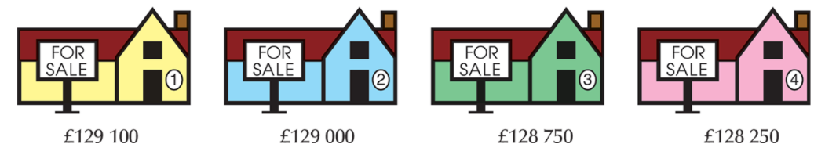
7. Here are the populations of five countries in 2022 | Arrange the countries in order of population, starting with the smallest.
8. Arrange these numbers in ascending order.
9. An estate agent advertises the following houses.
(a)Which house is the cheapest?
(b)Which house is the most expensive?
(c) George has just enough money to buy the cheapest house. How much more money would he need to buy the most expensive house?
Notes:
Answers

Slide 7

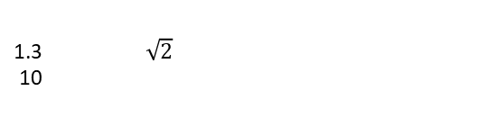
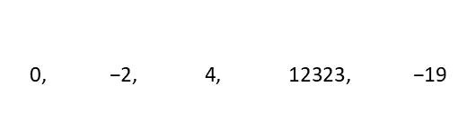


Ordering decimals
Definition
Characteristics
A decimal is a number that is not whole, as it lies between whole numbers.
Consists of a whole and a fraction part.
In a decimal, the fractional part is written as digits after a point rather than a fraction.
The whole and fraction parts are separated by a point called the decimal point.
Can be terminating or recurring.
Decimal
Examples
$$38$$
$$1\frac{2}{3}$$
Non - Examples
0.2 123.43 0.278
1.87 12.7657 10000.1 $0.\dot{6}$
4.0000000001 80.987654321 -3.43 $3.\dot{2} 3.\dot{2}746\dot{4}$
$$\frac{4}{5}$$
1.3 $\sqrt{2}$
10
1 × 20 = 20 | so 1 and 20 are both factors of 20
2 × 10 = 20 | so 2 and 10 are both factors of 20
4 × 5 = 20 | so 4 and 5 are both factors of 20
240
$$\text{0, −2, 4, 12323, −19}$$
 | For the following questions, use this number line to help you place the numbers in ascending order
Steps | 4.23, 4.52, 4.33 | 4.91, 4.21, 4.67 | 4.17, 4.68, 4.24
Look at the place value of the leftmost digit. Write down the number with the largest place value.
If any have the same place value, look at the digit to the right and write down the number with the lowest value. Repeat until all numbers have been ordered.
For the following questions, list the numbers in ascending order.
Example 7 - I do…
Example 8 – We do…
Example 9 – You do…

Slide 8
Independent Practice
15. For the following questions, list the numbers in ascending order.
a) 0.93, 0.96, 0.91, 0.99, 0.95
b) 1.47, 1.49, 1.40, 1.43, 1.41
c) 2.36, 2.38, 2.39, 2.33, 2.37
d) 0.16, 0.18, 0.12, 0.11, 0.15
e) 3.45, 3.52, 3.41, 3.58, 3.49
f) 4.67, 4.82, 4.46, 4.29, 4.65
g) 1.56, 1.78, 1.11, 1.03, 1.43
h) 2.64, 2.03, 2.17, 2.80, 2.54
 | For the following questions, use this number line to help you place the numbers in ascending order
Steps | 4.12, 4.21, 4.01 | 4.12, 4.31, 4.14 | 4.03, 4.31, 4.23
Look at the place value of the leftmost digit. Write down the number with the largest place value.
If any have the same place value, look at the digit to the right and write down the number with the highest value. Repeat until all numbers have been ordered.
Example 7 - I do…
For the following questions, list the numbers in descending order.
Example 10 - I do…
Example 11 – We do…
Example 12 – You do…

Slide 9
Arrange the numbers below in ascending order:
Steps | 4.35, 4.31, 4.6 | 4.7, 4.52, 4.59 | 4.4, 4.52, 4.51
Look at the place value of the leftmost digit. Write down the number with the largest place value.
If any have the same place value, look at the digit to the right and write down the number with the lowest value. Repeat until all numbers have been ordered.
Example 13 - I do…
Example 14 – We do…
Example 15 – You do…
Independent Practice
17. For the following questions, list the numbers in ascending order.
a) 6.34, 6.45, 6.3, 6.52, 6.28
b) 1.23, 1.3, 1.45, 1.09, 1.42
c) 3.6, 3.91, 3.07, 3.55, 3.9
d) 2.91, 2.2, 2.78, 2.01, 2.55
e) 1.9, 2.04, 2.3, 2.22, 1.98
f) 0.65, 0.5, 0.7, 0.06, 0.49
g) 3.99, 3.95, 4.01, 4.03, 3.9

Slide 10
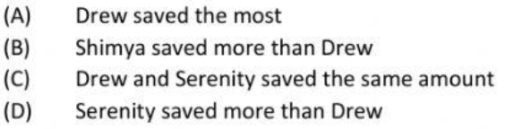
For the following questions, list the numbers in descending order.
Steps | 6.4, 6.72, 6.31, 7.5, 7 | 6.42, 6.87, 6, 7.1, 7.65 | 8, 7.4, 6.35, 7.35, 6.2
Look at the place value of the leftmost digit. Write down the number with the largest place value.
If any have the same place value, look at the digit to the right and write down the number with the largest value. Repeat until all numbers have been ordered.
Example 16 - I do…
Example 17 – We do…
Example 18 – You do…
Independent Practice
18. For the following questions, list the numbers in descending order.
a) 3.99, 3.95, 4.01, 4.03, 3.9
b) 0.78, 0.68, 0.79, 0.77, 0.7
c) 2.65, 2.69, 2.6, 2.72, 2.62
19.
a) Jadin weighs 96.5 pounds, Aaron weighs 89.09 pounds and Kavonia weighs 90.06 pounds. Order the students using their weights from heaviest to lightest.
b) Drew, Serenity and Shimya each save a portion of their £20 pocket money each week. Serenity saves 0.9, Shimya saves 0.75, and Drew saves 0.8 of pocket money. Circle the correct statement.

Slide 11
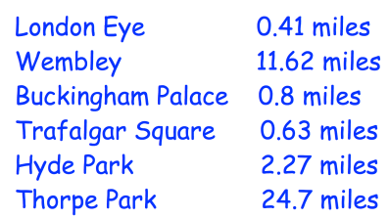
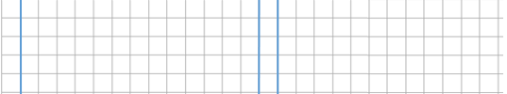
20. For the following questions, arrange the temperatures from highest to lowest.
a) 11 °C, 10.8°C, 12.3 °C, 15 °C, 12.7 °C | b) 8.5 °C, 0.7 °C, 3 °C, 0.9 °C, 6 °C, 1.3 °C, 5.1°C
21. For the following questions, order the amounts of money from lowest to highest.
a) £6.74, £10, £1.99, £8, £3.30, £2 | b) 80p, £1, £0.09, 23p, £2.75, £0.82, £20
24. The distance of various landmarks from Big Ben are listed below. | Arrange the landmarks in order, from closest to furthest.

Slide 12
Ordering negative numbers
Definition
Characteristics
Negative numbers are numbers that represent values that are less than zero. They show things like temperatures below zero, debts and losses.
Negative numbers have a negative sign (-) in front of them, telling us they are less than zero. They are smaller than positive numbers. They are like the opposite of positive numbers. Positive numbers are on the right side of zero, and negative numbers are on the left side.
When comparing negative numbers, the one with the smaller distance from zero is considered greater. For example, -3 is greater than -5 because -3 is closer to zero.
Examples
Negative Number
Non - Examples
Temperature: If the temperature drops below zero, like -10 degrees Celsius, it means it's colder than zero degrees.
Debt: When you owe money, the amount is represented by a negative number. For example, if you owe £100, it can be written as -£100.
-3 -10 -0.5 -⅔ -632.456
Positive Numbers: Positive numbers are greater than zero and are not negative.
Zero: Zero is not positive or negative.
5 0 2.5 ⅔ 200 45.67
For the following questions, list the numbers in ascending order.
Steps | -9, 9, 0, -1, -7 | -9, 9, 0, -11, -7 | -9, 9, 0, 11, -7
Look for the negative furthest from zero. This is the smallest number.
Repeat this step until all negatives have been ordered, then order the positives.
Example 25 - I do…
Example 26 – We do…
Example 27 – You do…

Slide 13
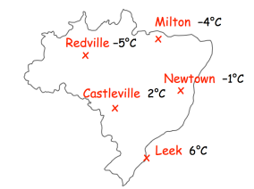
Independent Practice
28. For the following questions, list the numbers in ascending order.
a) -3, 13, 3, -2, 0, 1
b) -3, -1, 3, -7, 0, 14
c) -13, -1, 3, -7, 10, 14
d) 13, -11, 3, -72, 104, -4
e) 3, −5, 1, 0, −2, 4
f) −1, 8, −5, 2, −9, −4, 3
g) −1, −7, −2, 5, −6, 1
h) 10, −7, −3, 5, −9, −2, −12
29. Arrange the following temperatures in order, from lowest to highest.
a) -8°C, 12°C, 9°C, -15°C, 11°C, -7°C, 2°C
b) 2°C, −5°C, 4°C, 8°C, −3°C, 1°C, −7°C
c) 5°C, −3°C, 11°C, 9°C, −14°C, 21°C, −1°C
c) 19°C, -92°C, 93°C, -91°C, −29°C, 21°C, 0°C
 | 4. Arrange the towns in order of temperature, starting with the lowest.

Slide 14
Subtopic 2a – Rounding to nearest integer, or decimal places
LEARNING OUTCOME: To round numbers to the nearest 10, 100, 1000.
Objectives:
Keywords:
Approximation
Integer
Round
To round a whole number.
To round numbers to the nearest 10, 100,1000.
To answer worded questions about rounding.
Definition
Characteristics
Numbers round up or down depending on the value they are closer to.
If a number is exactly halfway between the two values it could round to, it rounds up
The process of finding an approximation for a number to a given accuracy
Examples
Rounding
Non - Examples
1853 = 1850 to the nearest 10
1853 = 1900 to the nearest 100
1853 = 2000 to the nearest 1000
18.53 = 19 to the nearest integer
1853 ≠ 50 to the nearest 10
35 ≠ 30 to the nearest 10
18.53 ≠ 19.00 to the nearest integer
18.68 ≠ 18.6 to one decimal place.
 | Example 1 – I do… | Example 2 – We do… | Example 3 – You do…
Steps | Round these numbers to the nearest 10. | Round these numbers to the nearest 10. | Round these numbers to the nearest 10.
Identify the value you’re rounding to above and the value below. Is it closer to the value above or the value below? | 53 125 | 67 165 | 86 135
 | Round these numbers to the nearest 100. | Round these numbers to the nearest 100. | Round these numbers to the nearest 100.
 | 489 1350 | 821 1150 | 676 1492
 | Round 143,981 to the nearest: | Round 25,865 to the nearest: | Round 162,912 to the nearest:
 | 100 1000 | 100 1000 | 100 1000
Notes:
https://www.bbc.co.uk/bitesize/guides/zscq6yc/revision/1

Slide 15
1. Round each number to the nearest 10:
32 |  | e) 59 |  | i) 845
b) 67 |  | f) 238 |  | j) 1628
c) 71 |  | g) 312 |  | k) 502
d) 24 |  | h) 333 |  | l) 7555
2. Round each number below to the nearest 100 a) 245 = _______ (nearest 100) b) 7620 = ______ (nearest 100) c) 4801 = _______ (nearest 100) d) 9450 = ______ (nearest 100)
e) 1234 = _______ (nearest 100) f) 1254 = _______ (nearest 100)
g) 12540 = _______ (nearest 100) h) 12054 = _______ (nearest 100)
i) 4708 = _______ (nearest 100) j) 3902.8 = _______ (nearest 100)
k) 76.34 = _______ (nearest 100) l) 24 = _______ (nearest 100)
3. Now round each number in question 3 to the nearest 1000 a) 4382 = _______ (nearest 1000) b) 43820 = _______ (nearest 1000)
c) 43280 = _______ (nearest 1000) d) 40328 = _______(nearest 1000)
e) 1234 = _______ (nearest 1000) f) 5839 = _______ (nearest 1000)
g) 12540 = _______ (nearest 1000) h) 12054 = _______ (nearest 1000)
i) 104,708 = _______ (nearest 1000) j) 3902.8 = _______ (nearest 1000)
k) 706.34 = _______ (nearest 1000) l) 324 = _______ (nearest 1000)

Slide 16
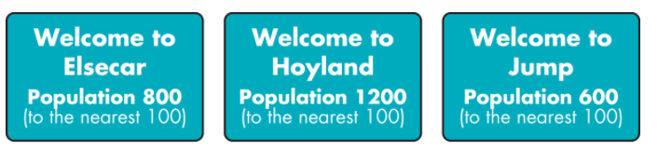
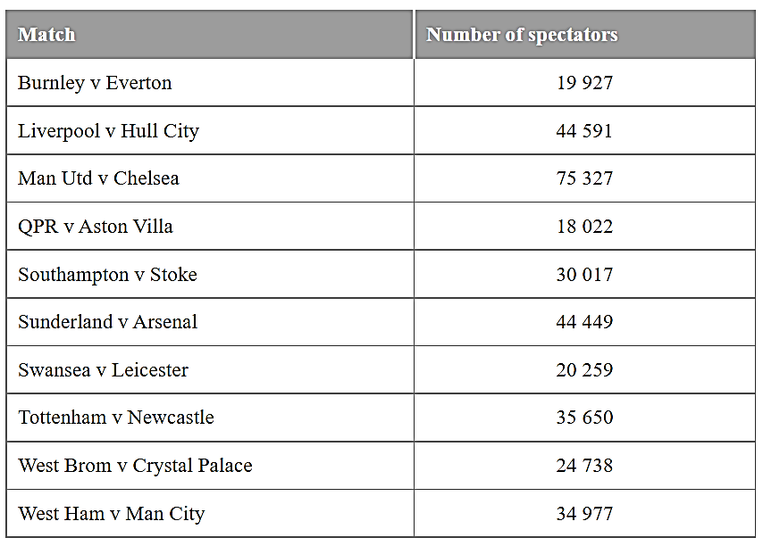
4. Round these numbers to the given degree of accuracy
Number | Rounded to the nearest 10 | Rounded to the nearest 100 | Rounded to the nearest 1000
6432
9256
40039
4555.9
5. Look at these signs.
Which of these sentences could be true? Which must be false?
There are 789 people living in Elsecar
b) There are 1278 people living in Hoyland
c) There are 550 people living in Jump
d) There are 843 people living in Elsecar
e) There are 1205 people living in Hoyland
f) There are 650 people living in Jump
6. The table shows the numbers of spectators in the crowds at ten Premier Division games on a weekend in October 2014.
Which match had the largest crowd?
b) Which had the smallest crowd?
c) Round all the numbers to the nearest 1000.
d) Round all the numbers to the nearest 100.

Slide 17
Rounding to decimal places
LEARNING OUTCOME: To be able to round to one, two and three decimal places.
Objectives:
Keywords:
Rounding
Integer
Decimal
To round decimal numbers to a given number of decimal places.
To able to answer worded questions involving rounding.
Definition
Characteristics
Approximating a number to the closest number of given accuracy.
After rounding the number will have the amount of decimal places that it has been rounded to.
Examples
Rounding to decimal places
Non - Examples
1.75 rounded to one decimal place is 1.8
It gets rounded up and there is only one digit after the point (in the tenths column)
5.98 rounded to one decimal place is not 6.
It is 6.0. You must include the tenths digit.
Rounding to the one decimal place (nearest tenth) using number lines
Example 1 - I do…
Steps:
Place the number on the number line.
See if the number is closer to the lower value or the upper value.
Write down what the number rounds to.
Round 2.35 to the one decimal place
2.35
2.3
2.4
2.35 rounded to 1 decimal place is
Example 2 - We do…
Example 3 - You do…
Round 4.12 to the one decimal place
Round 5.78 to the one decimal place
4.1
4.2
5.7
5.8
4.12 rounded to 1 decimal place is
rounded to 1 decimal place is

Slide 18
Independent Practice
1. Round each number to one decimal place
a) 0.45
b) 2.48
c) 3.48
0.4
0.5
2.4
2.5
3.4
3.5
rounded to the 1 decimal place is
rounded to the 1 decimal place is
rounded to the 1 decimal place is
d) 5.58
e) 7.69
f) 9.21
5.5
5.6
7.6
7.7
9.2
9.3
rounded to the 1 decimal place is
rounded to the 1 decimal place is
rounded to the 1 decimal place is
g) 9.91
h) 10.66
i) 12.76
9.9
10.0
10.6
10.7
12.7
12.8
rounded to the 1 decimal place is
rounded to the 1 decimal place is
rounded to the 1 decimal place is
j) 23.53
k) 24.61
l) 38.72
23.5
23.6
24.6
24.7
38.7
38.8
rounded to the 1 decimal place is
rounded to the 1 decimal place is
rounded to the 1 decimal place is
m) 50.59
n) 75.78
o) 84.58
50.5
50.6
75.7
75.8
84.5
84.6
rounded to the 1 decimal place is
rounded to the 1 decimal place is
rounded to the 1 decimal place is

Slide 19
Rounding without using a number line
Example 4 - I do…
Example 5 - We do…
Example 6 – You do…
Steps | Round each number to one decimal place.
1) Draw a line between the value in the tenths column and the hundredths column.
2) Underline the number in the hundredths column.
3) If it is below 5, then the tenths column stays the same.
4) If it is 5 or above, then the tenths column is rounded up
Round 0.58 to one decimal place
0 . 5 | 8
Round 2.92 to one decimal place
Round 3.69 to one decimal place
Round 2.21 to one decimal place
2 . 2 | 1
Round 5.05 to one decimal place
Round 4.78 to one decimal place
Independent Practice
2. Round each number to one decimal place.
a) 0.81
b) 0.85
c) 1.85
d) 1.89
e) 2.05
f) 2.65
g) 3.84
h) 3.88
i) 4.67
j) 4.81
k) 5.23
l) 5.28
m) 6.74
n) 6.89
o) 7.49
p) 7.52
q) 7.68
r) 7.91
Example 7 - I do…
Example 8 - We do…
Example 9 – You do…
Steps | Round each number to one decimal place.
1) Draw a line between the value in the tenths column and the hundredths column.
2) Underline the number in the hundredths column.
3) If it is below 5, then the tenths column stays the same.
4) If it is 5 or above, then the tenths column is rounded up.
Round 1.95 to one decimal place
1 . 9 | 5
Round 3.96 to one decimal place
Round 4.98 to one decimal place
Round 2.99 to one decimal place
2 . 9 | 9
Round 5.95 to one decimal place
Round 7.97 to one decimal place

Slide 20
Independent Practice
3. Round each number to one decimal place.
a) 0.95
b) 1.95
c) 2.95
d) 3.92
e) 3.94
f) 3.95
g) 4.99
h) 9.95
i) 5.97
j) 5.99
k) 7.96
l) 8.99
m) 9.98
n) 10.98
o) 12.97
p) 21.98
q) 27.99
r) 36.99
Rounding to two decimal places
Example 16 - I do…
Steps:
Place the number on the number line.
See if the number is closer to the lower value or the upper value.
Write down what the number rounds to.
Round 2.353 to two decimal places
2.353
2.35
2.36
2.353 rounded to 2 decimal places is
Example 17 - We do…
Example 18 - You do…
Round 3.129 to two decimal places
Round 4.782 to two decimal places
3.12
3.13
4.78
4.79
3.129 rounded to 2 decimal places is
rounded to 2 decimal places is

Slide 21
Independent Practice
6. Round each number to two decimal places.
a) 0.435
b) 2.483
c) 3.883
0.43
0.44
2.48
2.49
3.88
2.89
rounded to the 2 decimal places is
rounded to the 2 decimal places is
rounded to the 2 decimal places is
d) 5.582
e) 7.682
f) 9.214
5.58
5.59
7.68
7.69
9.21
9.22
rounded to the 2 decimal places is
rounded to the 2 decimal places is
rounded to the 2 decimal places is
Example 19 - I do…
Example 20 - We do…
Example 21 – You do…
Steps | Round each number to two decimal places.
1) Draw a line between the value in the hundredths column and the thousandths column.
2) Underline the number in the thousandths column.
3) If it is below 5, then the hundredths column stays the same.
4) If it is 5 or above, then the hundredths column is rounded up
Round 3.588 to two decimal places.
3 . 5 8 | 8
Round 4.491 to two decimal places.
Round 7.693 to two decimal places.
Round 19.997 to two decimal places.
Round 67.592 to two decimal places.
Round 71.395 to two decimal places.
Independent Practice
7. Round each number to two decimal places.
a) 1.594
b) 1.954
c) 1.495
d) 2.495
e) 2.954
f) 2.495
g) 3.159
h) 3.259
i) 3.952
j) 4.952
k) 7.925
l) 7.239

Slide 22
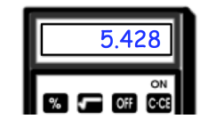



9. Round each number to one, two and three decimal places.
Number | 1 decimal place | 2 decimal places | 3 decimal places
1. 0.1234
2. 0.2345
3. 0.3456
4. 0.4567
5. 0.04567
6. 0.40567
7. 0.45067
8. 9.45067
9. 9.45967
10. 9.95967
10. Round each number to the decimal places specified.
a) $7.74026$
b) $13.49581$
c) $9.990099009$
1dp
2dp
3dp
4dp
1dp
2dp
3dp
4dp
5dp
6dp
7dp
8dp
11: 51.26% of the people living in a town are female. Round this figure to one decimal place.
12. Walter has worked out a calculation on a calculator.
Shown on the calculator is the answer. (a) Round the answer to one decimal place (b) Round the answer to two decimal places

Slide 23
Subtopic 9 – Rounding to significant figures
Subtopic 2b – Rounding to Significant Figures
LEARNING OUTCOME: To round decimals to a given degree of accuracy.
Objectives:
To be able to identify significant figures.
To be able to round to a given number of decimal places.
To be able to round to a given number of significant figures.
Keywords:
significant figure
Approximate
estimate
Definition
Characteristics
Numbers round up or down depending on the value they are closer to (and exactly halfway between rounds up).
The first significant figure is the first non-zero digit. All following digits count as significant.
The process of finding an approximation for a number to a given accuracy
Examples
Rounding
Non - Examples
170.8 = 200 to 1 significant figure
107.8 = 110 to 2 significant figures
0.01079 = 0.0108 to 3 significant figures
0.01038 = 0.010 to 2 significant figures
Identifying significant figures.
Example 1 - I do…
Example 2 - We do…
Example 3 – You do…
Identify which digit is the significant figure | Identify which digit is the significant figure
1) Identify the position of the first non-zero digit, starting from the left.
2) Count until you reach the required digit.
Which significant figure is the 5?
560
0.05
0.00475
Which significant figure is the 6?
260
0.61
0.00672
Which significant figure is the 4?
425
0.041
0.07041
23

Slide 24
Independent Practice
1. Which significant figure is the four?
a) 450
b) 540
c) 5400
d) 50400
e) 50040
f) 54000
g) 0.4
h) 0.504
i) 0.0504
j) 0.05043
k) 1.5004
l) 0.0050042
Rounding to one significant figure.
Example 4 - I do…
Example 5 - We do…
Example 6 – You do…
Steps | Round to 1 significant figure
1) Draw a line between the first and second significant figure.
2) If the 2nd significant figure is 5 or above, the 1st significant figure rounds up.
3) If the 2nd significant figure is 4 or below, the 1st significant figure stays the same.
Round 36 to one significant figure
3 | 6
Round 49 to one significant figure
Round 75 to one significant figure
Round 453 to one significant figure
4 | 5 3
Round 4353 to one significant figure
Round 4531 to one significant figure
Independent Practice
2. Round each number to 1 significant figure.
a) 12
b) 15
c) 24
d) 27
e) 35
f) 39
g) 390
h) 395
i) 401
j) 450
k) 570
l) 690
m) 1200
n) 1500
o) 1005
p) 1050
q) 2950
r) 2095
s) 2495
t) 2945
u) 3059
v) 3595
w) 8099
x) 6499

Slide 25
y) 12100
z) 46100
a1) 65400
b1) 95120
c1) 96290
d1) 863000
Example 7 - I do…
Example 8 - We do…
Example 9 – You do…
Steps | Round to 1 significant figure
1) Draw a line between the first and second significant figure.
2) If the 2nd significant figure is 5 or above, the 1st significant figure rounds up.
3) If the 2nd significant figure is 4 or below, the 1st significant figure stays the same.
Round 1.25 to one significant figure
1 | 2 5
Round 3.95 to one significant figure
Round 7.75 to one significant figure
Round 17.68 to one significant figure
1 | 7 . 6 8
Round 15.98 to one significant figure
Round 17.59 to one significant figure
Independent Practice
3. Round each number to 1 significant figure.
a) 2.4
b) 2.5
c) 2.9
d) 3.9
e) 4.9
f) 4.91
g) 3.91
h) 3.95
i) 4.15
j) 4.55
k) 5.75
l) 6.76
m) 12.7
n) 15.1
o) 15.5
p) 15.9
q) 17.5
r) 19.9
s) 24.95
t) 29.45
u) 30.59
v) 35.95
w) 80.99
x) 64.99

Slide 26
Example 10 - I do…
Example 11 - We do…
Example 12 – You do…
Steps | Round to 1 significant figure
1) Draw a line between the first and second significant figure.
2) If the 2nd significant figure is 5 or above, the 1st significant figure rounds up.
3) If the 2nd significant figure is 4 or below, the 1st significant figure stays the same.
Round 0.25 to one significant figure
0 . 2 | 5
Round 0.31 to one significant figure
Round 0.75 to one significant figure
Round 0.0378 to one significant figure
0 . 0 3 | 7 8
Round 0.0392 to one significant figure
Round 0.0431 to one significant figure
Independent Practice
4. Round each number to 1 significant figure.
a) 0.41
b) 0.45
c) 0.49
d) 0.55
e) 0.59
f) 0.91
g) 0.95
h) 0.905
i) 0.951
j) 0.091
k) 0.095
l) 0.059
m) 0.0591
n) 0.0045
o) 0.0054
p) 0.00501
q) 0.0505
r) 0.005905
Rounding to two significant figures.
Example 13 - I do…
Example 14 - We do…
Example 15 – You do…
Steps | Round to 2 significant figures
1) Draw a line between the second and third significant figure.
2) If the 3rd significant figure is 5 or above, the 2nd significant figure rounds up.
3) If the 3rd significant figure is 4 or below, the 2nd significant figure stays the same.
Round 467 to two significant figures
4 6 | 7
Round 4670 to two significant figures
Round 7592 to two significant figures

Slide 27
Independent Practice
5. Round each number to 2 significant figures.
a) 314
b) 351
c) 392
d) 395
e) 405
f) 455
g) 1200
h) 1250
i) 1255
j) 2359
k) 4395
l) 5095
m) 7059
n) 8679
o) 12500
p) 13550
q) 14609
r) 156500
Example 16 - I do…
Example 17 - We do…
Example 18 – You do…
Steps | Round to 2 significant figures
1) Draw a line between the second and third significant figure.
2) If the 3rd significant figure is 5 or above, the 2nd significant figure rounds up.
3) If the 3rd significant figure is 4 or below, the 2nd significant figure stays the same.
Round 1.25 to two significant figures
1 . 2 | 5
Round 3.98 to two significant figures
Round 7.75 to two significant figures
Round 17.68 to two significant figures
1 7 | 6 8
Round 13.98 to two significant figures
Round 27.95 to two significant figures
Independent Practice
6. Round each number to 2 significant figures.
a) 1.31
b) 1.35
c) 2.39
d) 7.93
e) 9.19
f) 9.99
g) 10.5
h) 10.9
i) 12.5
j) 12.55
k) 12.99
l) 15.37

Slide 28
m) 16.37
n) 19.79
o) 19.59
p) 24.95
q) 24.955
r) 25.095
s) 126.4
t) 196.4
u) 125.5
v) 135.5
w) 135.55
x) 195.89
Example 19 - I do…
Example 20 - We do…
Example 21 – You do…
Steps | Round to 2 significant figures
1) Draw a line between the second and third significant figure.
2) If the 3rd significant figure is 5 or above, the 2nd significant figure rounds up.
3) If the 3rd significant figure is 4 or below, the 2nd significant figure stays the same.
Round 0.253 to two significant figures
0 . 2 5 | 3
Round 0.937 to two significant figures
Round 0.751 to two significant figures
Round 0.0685 to two significant figures
0 . 0 6 8 5
Round 0.0817 to two significant figures
Round 0.0952 to two significant figures
Independent Practice
7. Round each number to 2 significant figures.
a) 0.315
b) 0.351
c) 0.359
d) 0.399
e) 0.193
f) 0.1931
g) 0.1913
h) 0.1935
i) 0.1953
j) 0.1955
k) 0.1995
l) 0.1999
m) 0.0156
n) 0.0165
o) 0.0564
p) 0.0565
q) 0.0599
r) 0.009559

Slide 29
Rounding to three significant figures.
Example 22 - I do…
Example 23 - We do…
Example 24 – You do…
Steps | Round to 3 significant figures
1) Draw a line between the third and forth significant figure.
2) If the 4th significant figure is 5 or above, the 3rd significant figure rounds up.
3) If the 4th significant figure is 4 or below, the 3rd significant figure stays the same.
Round 16740 to three significant figures
1 6 7 4 0
Round 24520 to three significant figures
Round 26380 to three significant figures
Round 1.674 to three significant figures
1 . 6 7 4
Round 3.065 to three significant figures
Round 7.507 to three significant figures
Round 0.1674 to three significant figures
0 . 1 6 7 4
Round 0.8295 to three significant figures
Round 0.7975 to three significant figures
Independent Practice
8. Round each number to 3 significant figures.
a) 15560
b) 15780
c) 16790
d) 16850
e) 16855
f) 16899
g) 24689
h) 25789
i) 18649
j) 2.359
k) 4.395
l) 5.095
m) 7.059
n) 8.679
o) 12.59
p) 13.554
q) 14.609
r) 156.53

Slide 30
s) 126.49
t) 196.45
u) 125.505
v) 139.509
w) 199.502
x) 199.99
y) 0.573
z) 0.4675
a1) 0.0574
b1) 0.05866
c1) 0.09095
d1) 0.01999
9. Complete the following table by rounding each number to 1, 2 and 3 significant figures
 | 1sf | 2sf | 3sf
123.456
144.402
8888.888
437.3946
987.654
3 809 830.492
1.98043
4.80808
99.009900
10. In an election 43.86% of people voted for a candidate. Round this figure to one significant figure
11. 32641 people watch a rugby match between Italy and Argentina. Round this number to 2 significant figures.

Slide 31

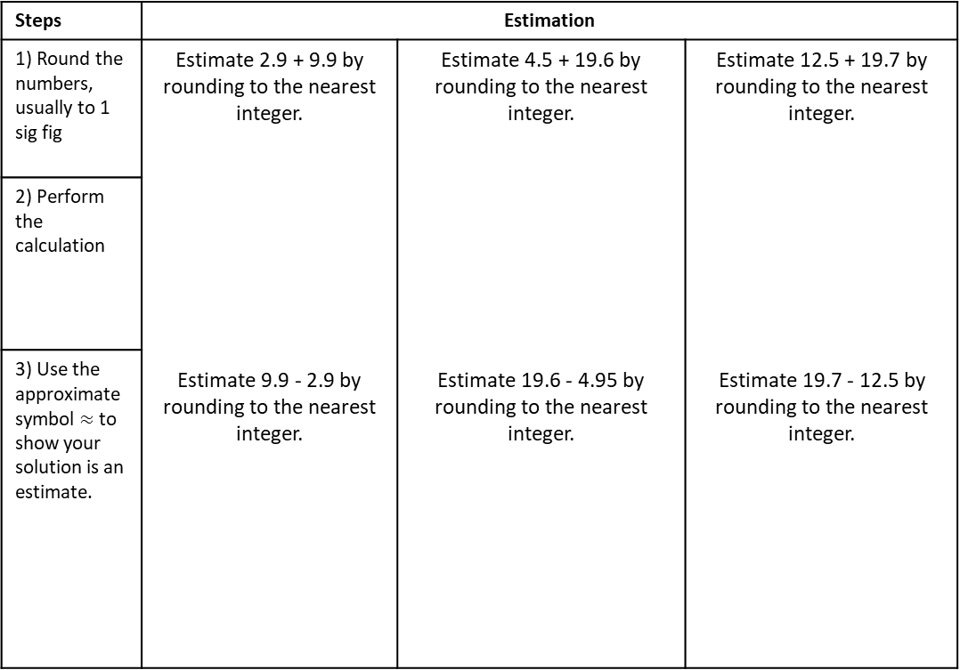
Subtopic 3 – Estimation
LEARNING OUTCOME: To use estimation to solve problems.
Objectives:
To be able to use rounding to estimate calculations.
To estimate with powers and roots.
Keywords:
significant figure
Approximate
estimate
Definition
Characteristics
Calculating an approximate answer to a calculation by rounding the numbers used in the calculation prior to carrying the calculation.
Typically, number used in the calculation will be rounded to 1 significant figure
The result of the calculation will be close to the real answer
Examples
Estimating (a calculation)
Non - Examples
27 × 432 ≈ 30 × 400
27 × 432 =
$$\frac{73.8×23.93}{0.345}≈\frac{70×20}{0.3}$$
 | 400 | 30 | 2
20 | 8000 | 600 | 40
7 | 2800 | 210 | 14
Example 1 - I do…
Example 2 - We do…
Example 3 – You do…
Steps | Estimation
1) Round the numbers, usually to 1 sig fig | Estimate 2.9 + 9.9 by rounding to the nearest integer. Estimate 9.9 - 2.9 by rounding to the nearest integer. | Estimate 4.5 + 19.6 by rounding to the nearest integer. Estimate 19.6 - 4.95 by rounding to the nearest integer. | Estimate 12.5 + 19.7 by rounding to the nearest integer. Estimate 19.7 - 12.5 by rounding to the nearest integer.
2) Perform the calculation
3) Use the approximate symbol $≈$ to show your solution is an estimate.
31

Slide 32
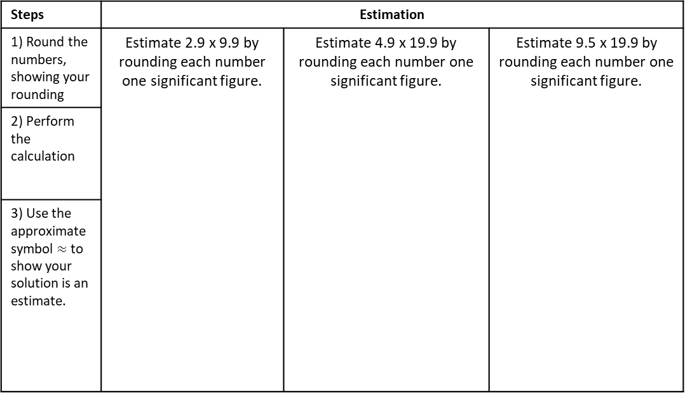
Independent Practice
1. Estimate the answer to each by rounding each
number to the nearest integer
a) 0.99 + 17.9
b) 0.99 + 19.9
c) 0.99 + 25.9
d) 1.95 + 17.9
e) 2.95 + 17.95
f) 17.9 - 0.9
g) 17.95 - 0.9
h) 16.95 - 2.9
i) 16.95 – 5.8
j) 16.95 – 5.85
Example 4 - I do…
Example 5 - We do…
Example 6 – You do…
Steps | Estimation
1) Round the numbers, showing your rounding | Estimate 2.9 x 9.9 by rounding each number one significant figure. | Estimate 4.9 x 19.9 by rounding each number one significant figure. | Estimate 9.5 x 19.9 by rounding each number one significant figure.
2) Perform the calculation
3) Use the approximate symbol $≈$ to show your solution is an estimate.
32

Slide 33
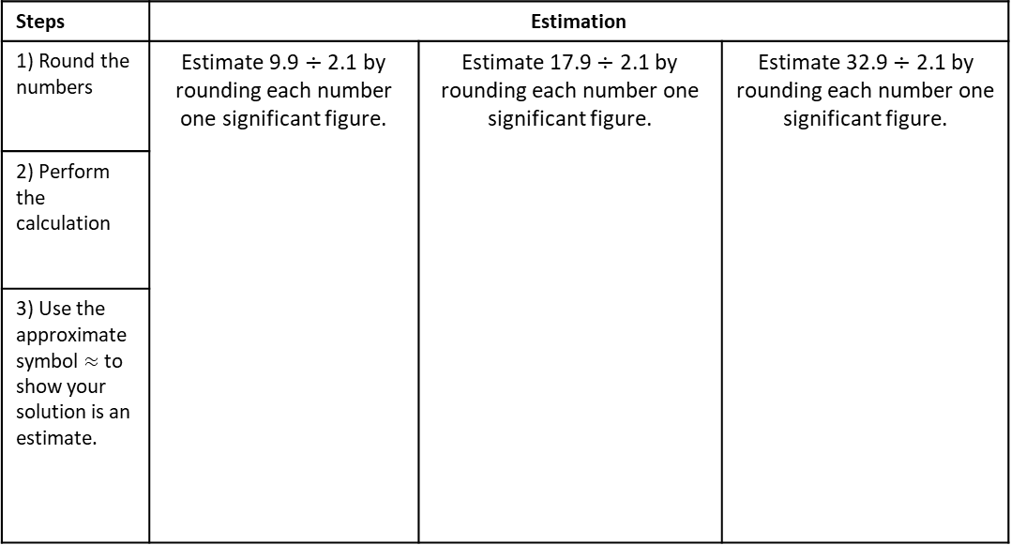
Independent Practice
2. Estimate the answer to each by rounding each
number to one significant figure.
a) 0.99 x 1.99
b) 1.95 x 9.9
c) 2.99 x 9.5
d) 4.95 x 9.98
e) 4.95 x 9.99
f) 9.5 x 11.9
g) 9.5 x 14.9
h) 15.1 x 9.5
Example 7 - I do…
Example 8 - We do…
Example 9 – You do…
Steps | Estimation
1) Round the numbers | Estimate 9.9 $÷$ 2.1 by rounding each number one significant figure. | Estimate 17.9 $÷$ 2.1 by rounding each number one significant figure. | Estimate 32.9 $÷$ 2.1 by rounding each number one significant figure.
2) Perform the calculation
3) Use the approximate symbol $≈$ to show your solution is an estimate.

Slide 34












Independent Practice
3. Estimate the answer to each by rounding each
number to one significant figure.
a) 7.9 $÷$ 1.99
b) 9.9 $÷$ 1.99
c) 9.9 $÷$ 4.95
d) 19.5 $÷$ 1.99
e) 19.5 $÷$ 4.05
f) 19.5 $÷$ 5.19
g) 24.9 $÷$ 4.99
h) 34.9 $÷$ 6.4
g) 104.5 $÷$ 4.9
h) 212.6 $÷$17.8
i) 147.2 $÷$ 9.76
j) 134.9 $÷$ 45.9

Slide 35



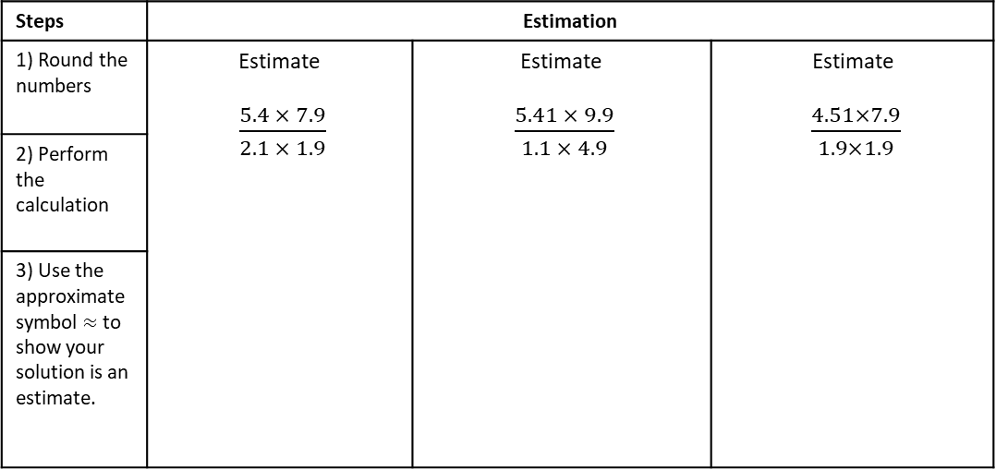





Example 10 - I do…
Example 11 - We do…
Example 12 – You do…
Steps | Estimation
1) Round the numbers | Estimate $\frac{5.4 × 7.9}{2.1 × 1.9}$ | Estimate $\frac{5.41 × 9.9}{1.1 × 4.9}$ | Estimate $\frac{4.51×7.9}{1.9×1.9}$
2) Perform the calculation
3) Use the approximate symbol $≈$ to show your solution is an estimate.
Independent Practice
4. Estimate the answer to each by rounding each
number to one significant figure.
a) $\frac{4.8 ×15}{10.5}$
b) $\frac{4.8 ×15}{15.5}$
c) $\frac{4.8 ×2.3}{2.3}$
d) $\frac{48 × 23}{23}$
e) $\frac{48 × 23}{2.3 ×4.8}$
f) $\frac{48 × 23}{2.35 ×4.87}$
g) $\frac{48 × 23}{23.5 ×4.87}$
h) $\frac{4.8 × 2.3}{2.35 ×4.87}$

Slide 36






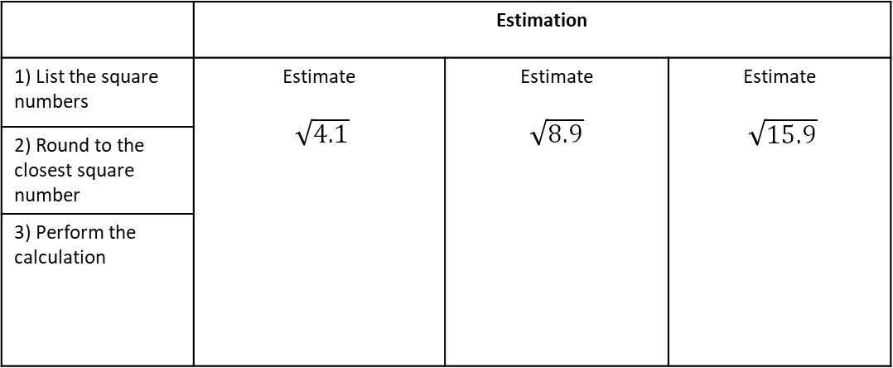









Example 13 - I do…
Example 14 - We do…
Example 15 – You do…
 | Estimation
1) List the square numbers | Estimate $\sqrt{4.1}$ | Estimate $\sqrt{8.9}$ | Estimate $\sqrt{15.9}$
2) Round to the closest square number
3) Perform the calculation
Independent Practice
5. Estimate the answer to each by rounding each
number to the nearest integer
a) $\sqrt{0.9}$
b) $\sqrt{1.1}$
c) $\sqrt{3.8}$
d) $\sqrt{4.4}$
e) $\sqrt{9.2}$
f) $\sqrt{24.9}$
g) $\sqrt{36.3}$
h) $\sqrt{48.9}$
i) $\sqrt{80.94}$
j) $\sqrt{63.952}$
f) $\sqrt{25.18}$
g) $\sqrt{99.99}$
h) $\sqrt{101.37}$
i) $\sqrt{143.94}$
j) $\sqrt{144.0062}$

Slide 37



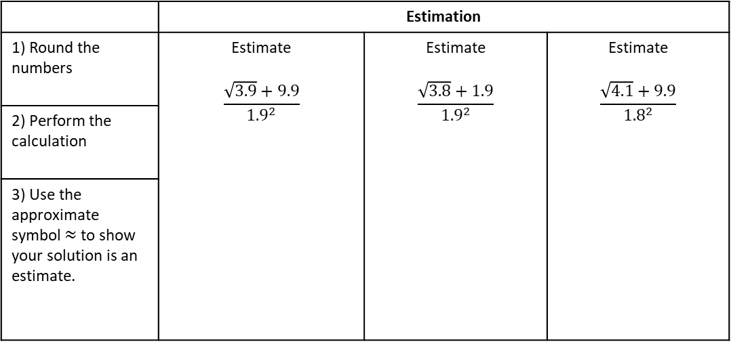





Multi-step Estimation
Example 19 - I do…
Example 20 - We do…
Example 21 – You do…
 | Estimation
1) Round the numbers | Estimate $$\frac{\sqrt{3.9}+9.9}{{1.9}^{2}}$$ | Estimate $$\frac{\sqrt{3.8}+1.9}{{1.9}^{2}}$$ | Estimate $$\frac{\sqrt{4.1}+9.9}{{1.8}^{2}}$$
2) Perform the calculation
3) Use the approximate symbol $≈$ to show your solution is an estimate.
Independent Practice
6. Estimate by rounding
a) $\frac{\sqrt{9.1} + 9.9}{{0.9}^{2}}$
b)$\frac{\sqrt{8.9} + 9.9}{{0.9}^{2}}$
c)$\frac{\sqrt{8.9} +10.1}{{1.1}^{2}}$
d) $\frac{9.5 + \sqrt{8.8}}{{1.1}^{2}}$
f) $\frac{{1.9}^{2} × 9.9}{\sqrt{4.1}}$
g)$\frac{{2.9}^{2} × 9.9}{\sqrt{4.1}}$
h)$\frac{4.1 ×{4.1}^{2}}{7.9}$
i) $\frac{{5.9}^{2} × \sqrt{4.1}}{11.9}$

Slide 38
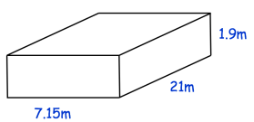
8. Estimate the total cost of 32 printers at £198 each and 58 ink cartridges at £31.15 each.
9. In a cinema there are 28 rows and in each row there are 22 seats. Each ticket costs £8.10 Work out an estimate for the total income from the ticket sales
10. Lauren is given two job offers Job A: £785 a week Job B: £1950 a month Which job is offering the greatest pay?
11. A buzzer beeps every 1,111 seconds. Work out an estimate for the number of times the buzzer beeps in 1 week.
12. Andrew is going to fill an empty swimming pool. Andrew fills the swimming pool with water at a constant rate of 2.1 litres per second.
Given 1m³ = 1000 litres, estimate how long it takes to fill the pool
13. Estimate $\frac{\sqrt[3]{124} ×{3.9}^{2}}{\sqrt{15.9} × 1.9}$

Slide 39
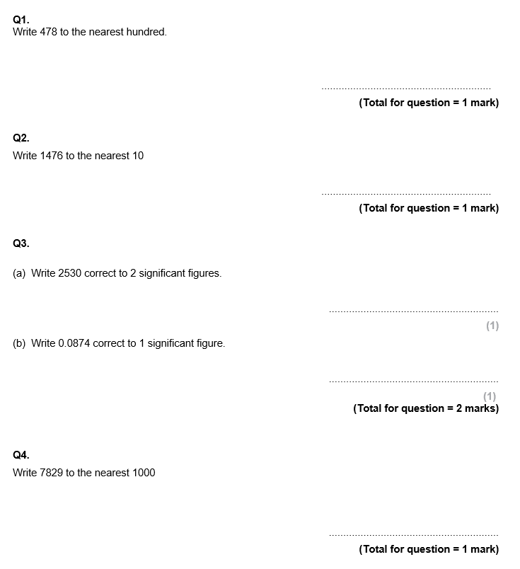
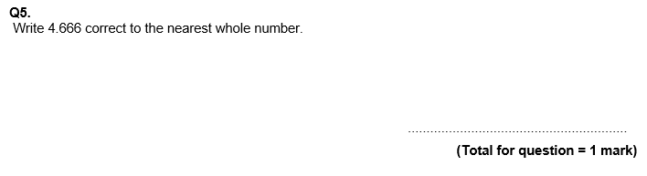
GCSE Questions

Slide 40
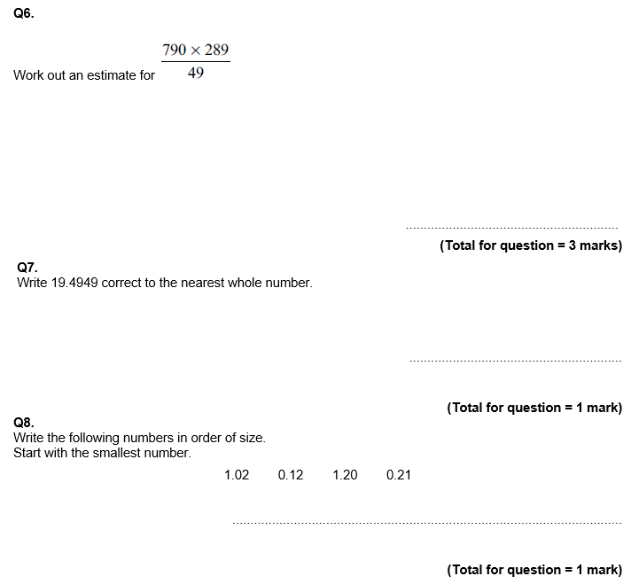
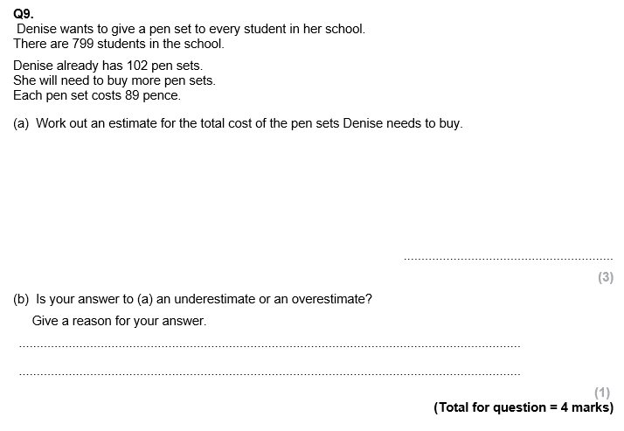

Slide 41
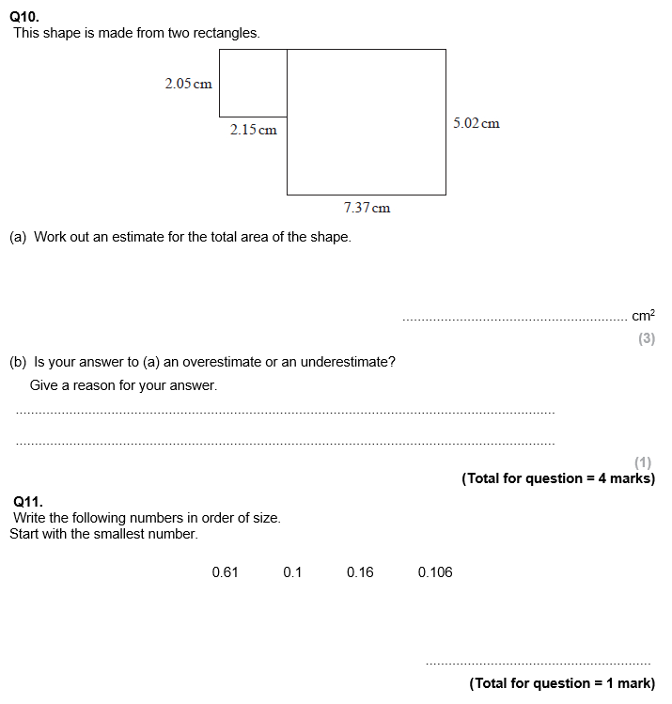
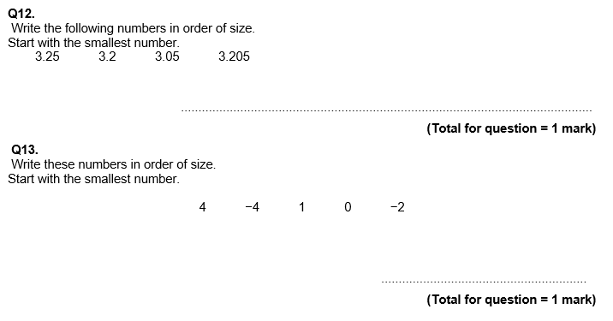

Slide 42
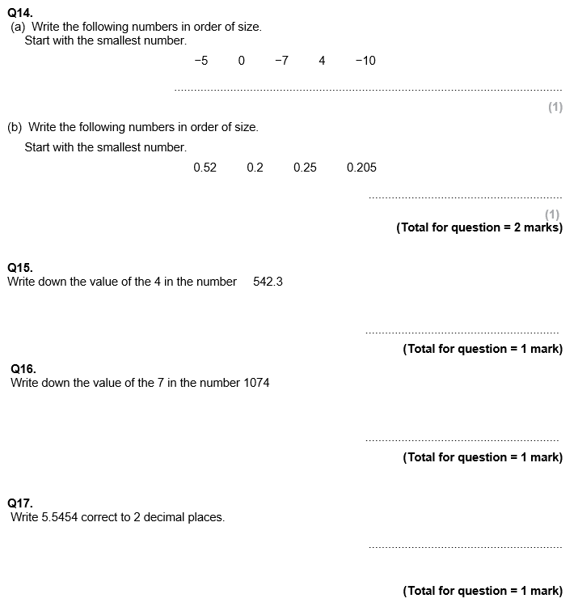

Slide 43

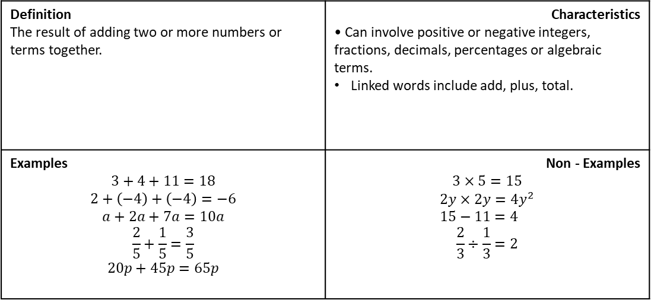
Subtopic 4 – The Four Operations
LEARNING OUTCOME: To use the four rules of arithmetic with integers and decimals.
Objectives:
Keywords:
Sum
Difference
Division
Multiplication
To add and subtract positive numbers.
To multiply and divide positive numbers.
To solve problems using different rules of arithmetic.
Definition The result of adding two or more numbers or terms together. | Characteristics • Can involve positive or negative integers, fractions, decimals, percentages or algebraic terms. Linked words include add, plus, total.
Examples $$3+4+11=18$$ $$2+\left(−4\right)+\left(−4\right)=−6 \\ a+2a+7a=10a \\ \frac{2}{5}+\frac{1}{5}=\frac{3}{5} \\ 20p+45p=65p$$ | Non - Examples $$3×5=15$$ $$2y×2y=4y^{2} \\ 15−11=4$$ $$\frac{2}{3}÷\frac{1}{3}=2$$
Addition/Sum
Addition
Example 1- I do…
Example 2 - We do…
Example 3 - You do…
Steps | Calculate 15 + 3 | Calculate 17 + 2 | Calculate 11 + 8
Line up both numbers in the correct columns 2. Add each column starting with the lowest column
 | T | O
 | 1 | 5
+ |  | 3
 | T | O
+
 | T | O
+
Notes:
OBJECTIVES

Slide 44
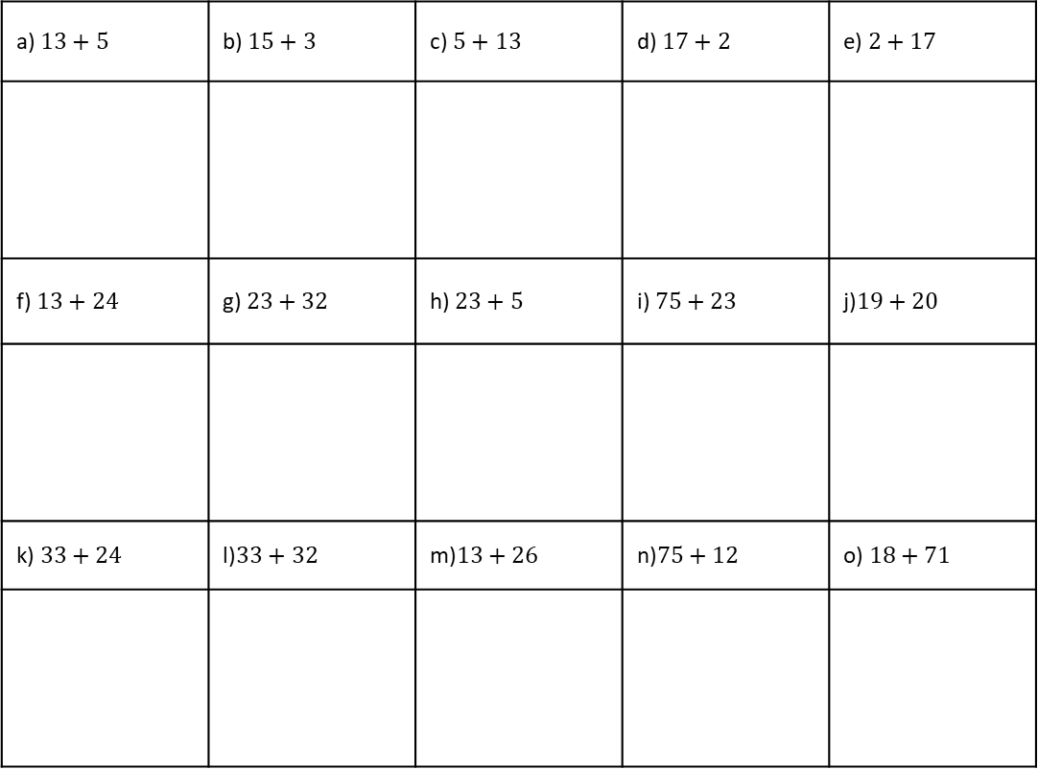
Setting out and adding one- and two-digit integers using column method
Example 4 - I do…
Example 5 - We do…
Example 6 - You do…
Steps | Calculate 5 + 37 | Calculate 18 + 75 | Calculate 54 + 17
1. Line up both numbers in the correct columns
2. Add each column starting with the lowest column
Independent Practice
1. Add the following integers using column method
a) $13+5$ | b) $15+3$ | c) $5+13$ | d) $17+2$ | e) $2+17$
f) $13+24$ | g) $23+32$ | h) $23+5$ | i) $75+23$ | j)$19+20$
k) $33+24$ | l)$33+32$ | m)$13+26$ | n)$75+12$ | o) $18+71$
p) Sally is calculating 438 + 100. Can you explain the mistake she has made?
4 3 8
+ 1 0 0
4 4 8 0

Slide 45
Setting out and adding three-digit integers using column method involving exchanges
Example 7 - I do…
Example 8 - We do…
Example 9 - You do…
Steps
1. Line up numbers in the correct columns
2. Add each column starting with the lowest
3. Write how many groups of ten are exchanged
4. Add this to your next column and repeat
Calculate 425 + 878
Calculate 248 + 67
Calculate 455 + 775
Independent Practice
1. Add the following integers using column method
Independent Practice
2. Add the following integers using column method
a) 352 + 451 =
b) 255 + 182 =
c) 458 + 379 =
d) 356 + 45 =
e) 259 + 67 =
f) 456 + 79 =
g) Find the sum of 796 and 455
h) Find the sum of 89 and 678
i) Find the sum of 49 and 887

Slide 46

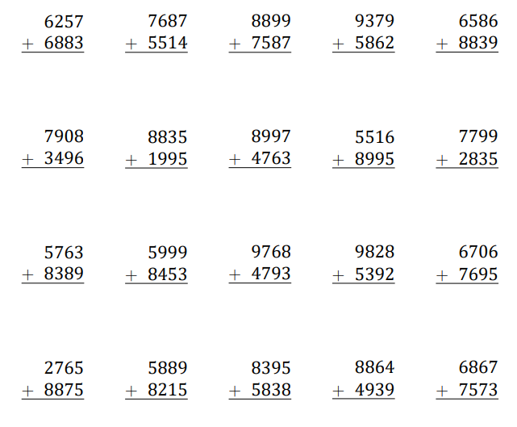
Adding four- digit integers using column method involving exchanges
Example 10 I do…
Example 11 - We do…
Example 12 - You do…
Steps | Calculate 9851 + 3279 | Calculate 5852 + 5378 | Calculate 8963 + 3267
1. Add each column starting with the lowest column
2. Write how many groups of ten are exchanged
3. Add this to your next column
+
9 8 5 1
3 2 7 9
+
5 8 5 2
5 3 7 8
+
8 9 6 3
3 2 6 7
Independent Practice
3. Add the following integers using column method
a) b) c) d) e)
f) g) h) i) j)
k) l) m) n) o)
p) q) r) s) t)

Slide 47
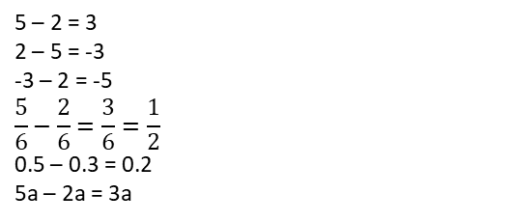
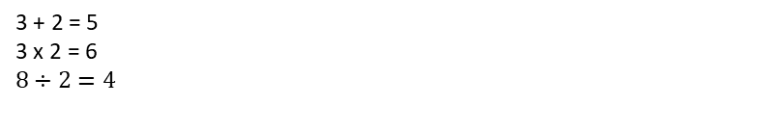
Subtraction
Definition
Characteristics
• Can involve positive or negative integers, fractions, decimals, percentages or algebraic terms.
Linked words include minus, difference, less than, reduce.
A mathematical operation in which the difference between two numbers or quantities is calculated.
Examples
SUBTRACT
Non - Examples
5 – 2 = 3
2 – 5 = -3
-3 – 2 = -5
$$\frac{5}{6}−\frac{2}{6}=\frac{3}{6}=\frac{1}{2}$$
0.5 – 0.3 = 0.2
5a – 2a = 3a
3 + 2 = 5
3 x 2 = 6
$$8÷2=4$$
.
 | For the following questions, use this number line to help you place the numbers in ascending order
Steps | 83 – 52 | 96 – 24 | 45 – 32
1) Write the numbers in columns, ensuring that they are lined up correctly.
2) Starting from the ones column, complete subtraction.
Example 13 - I do…
Example 14 – We do…
Example 15 – You do…
Notes:
OBJECTIVES

Slide 48
Example 16 - I do…
Example 17 – We do…
Example 18 – You do…
Steps | 5183 – 52 | 4782 – 41 | 3494 - 23
1) Write the numbers in columns, ensuring that they are lined up correctly.
2) Starting from the ones column, complete subtraction.
Independent Practice
9. For the following questions, use the column method to work out the subtraction problems:
a) 79 – 22 | b) 89 – 22 | c) 89 – 11
d) 89 – 17 | e) 19 – 17 | f) 99 – 17
g) 197 – 12 | h) 297 – 12 | i) 297 – 61

Slide 49
j) 298 – 91 | k) 298 – 71 | l) 497 – 71
m) 785 – 512 | n) 859 – 132 | o) 557 – 319
p) 946 – 230 | q) 4854 – 1132 | r) 4871 – 1540
s) 5792 – 4431 | t) 4781 – 1650 | u) 48832 – 14501

Slide 50
Example 19 - I do…
Example 20 – We do…
Example 21 – You do…
Steps | 94 - 36 | 62 - 28 | 53 - 39
1) Write the numbers in columns, ensuring that they are lined up correctly.
2) Starting from the ones column, complete subtraction.
3) Exchange where appropriate.
Example 22 - I do…
Example 23 – We do…
Example 24 – You do…
Steps | 3417 - 58 | 6423 - 49 | 7342 - 95
1) Write the numbers in columns, ensuring that they are lined up correctly.
2) Starting from the ones column, complete subtraction.
3) Exchange where appropriate.

Slide 51
Independent Practice
10. For the following questions, use the column method to work out the subtraction problems:
a) 67 – 24 | b) 78 – 29 | c) 92 - 38
d) 105 – 83 | e) 123 - 89 | f) 150 - 62
g) 156 - 74 | h) 187 - 105 | i) 267 – 194
j) 312 – 187 | k) 398 – 256 | l) 1452 - 898

Slide 52
Example 25 - I do…
Example 26 – We do…
Example 27 – You do…
Steps | John buys a chocolate bar for £1.55 and a lemonade for £0.98. How much more expensive is the chocolate bar than the lemonade? | At a football match, there are 8509 united fans and 6883 city fans. How many more united fans are there than city fans? | Kelly has 25 marbles and Hannah has 144 marbles. How many more marble does Hannah have than Kelly?
1) Write the numbers in columns, ensuring that they are lined up correctly.
2) Starting from the ones column, complete subtraction.
Independent Practice
11. Sarah buys an apple for 41p and a banana for 27p. How much more expensive is an apple than a banana?
12. Kelly has 76 marbles and Hannah has 102 marbles. How many more marble does Hannah have than Kelly?
13. At a football match there are 2942 Rovers fans and 9381 City fans. How many more fans did City have?
14. Theo wants to buy a laptop that costs £425. Theo has saved £267 so far. How much more money does Theo need to save?

Slide 53
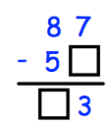
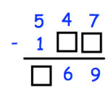
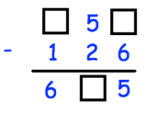
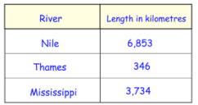
15. For the following questions, fill in the missing numbers.
a) | b) |  | c)
16. The table shows the lengths of three rivers. |  | How much longer is the Nile than the combined lengths of the other two rivers?
17. Work out the difference between 234,789 and 502,113

Slide 54
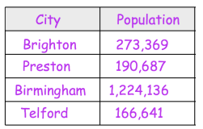


18. This table shows the number of people living in various cities in England. | How many more people live in Birmingham than Preston?
19. For the following questions, fill in the missing numbers.
a) | b)
20. Write down the number that is ten thousand less than two million.

Slide 55

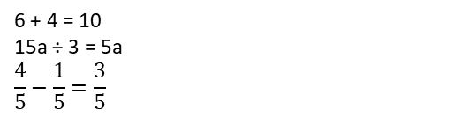
Multiplication
Definition
Characteristics
The result of multiplying two or more numbers or terms together.
3 x 5 = 15
Products are not always larger than their factors
Product
Factors
Examples
Multiplication/Product
Non - Examples
2 x 3 = 6
9 x -3 = -27
½ x ¾ = $\frac{3}{8}$
2a x 2a = 4a²
6 + 4 = 10
15a ÷ 3 = 5a
$$\frac{4}{5}−\frac{1}{5}=\frac{3}{5}$$
Example 28 - I do…
Example 29 – We do…
Example 30– You do…
Calculate: 34 x 7 | Calculate: 43 x 7 | Calculate: 36 x 7
Independent Practice
21. Without a calculator, calculate the following:
a) 32 x 3 | b) 23 x 3 | c) 46 x 7
d) 46 x 9 | e) 9 x 46 | f) 98 x 7
Notes:
Example 7 – division sign

Slide 56
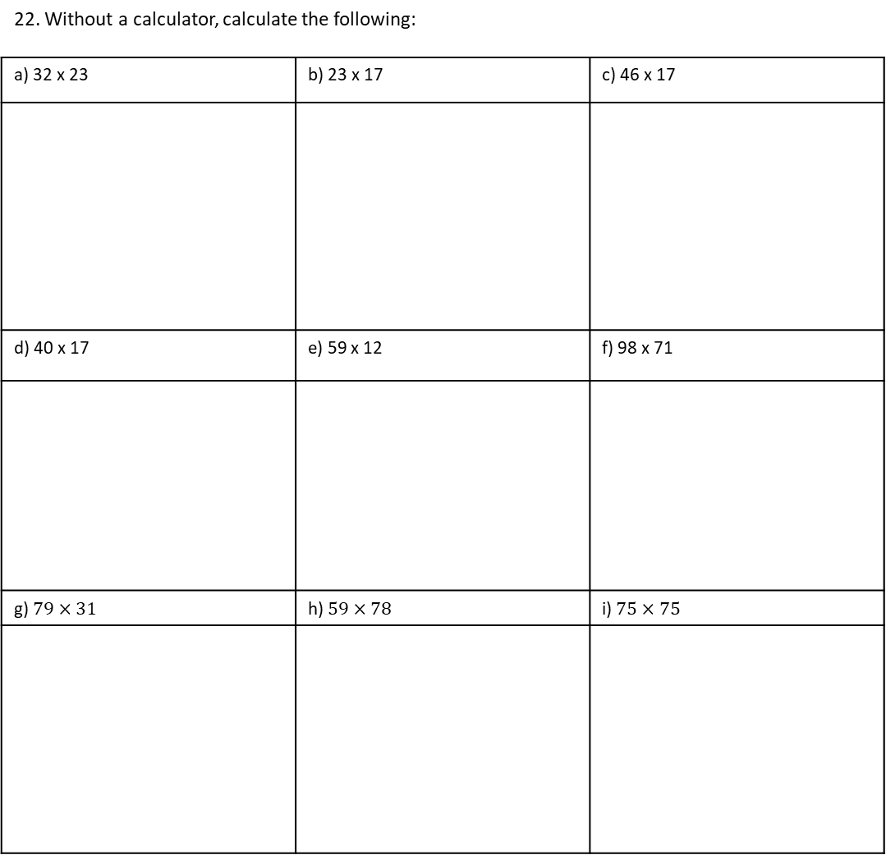
14 x 27 | 23 x 35 | 18 x 37
Example 31 - I do…
Example 32 – We do…
Example 33 – You do…
Independent Practice
22. Without a calculator, calculate the following:
a) 32 x 23 | b) 23 x 17 | c) 46 x 17
d) 40 x 17 | e) 59 x 12 | f) 98 x 71
g) $79×31$ | h) $59×78$ | i) $75×75$

Slide 57


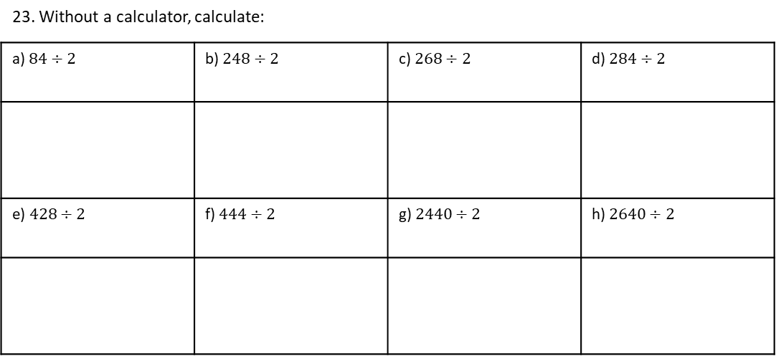
Short Division
Definition
Characteristics
A number by which another number is divided
425 ÷ 5 = 85
$$\frac{425}{5}=85$$
Divisor
Examples
Divisor
Non - Examples
6 ÷ 3 = 2
3 is the divisor
Cannot be the numerator of a fraction
Example 34 - I do…
Example 35 – We do…
Example 36 – You do…
Steps | Calculate: $242÷2$ | Calculate: $420÷2$ | Calculate: $224÷2$
1) Set out the numbers in the correct layout.
2) Complete the division, carrying where appropriate.
Independent Practice
23. Without a calculator, calculate:
a) $84÷2$ | b) $248÷2$ | c) $268÷2$ | d) $284÷2$
e) $428÷2$ | f) $444÷2$ | g) $2440÷2$ | h) $2640÷2$
Notes:
Example 7 – division sign

Slide 58
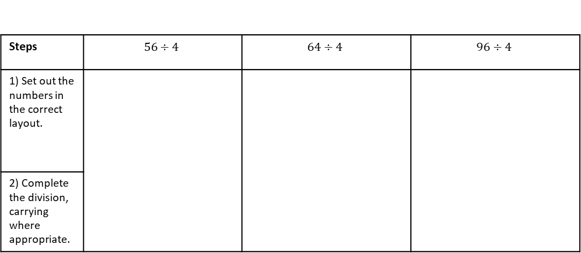

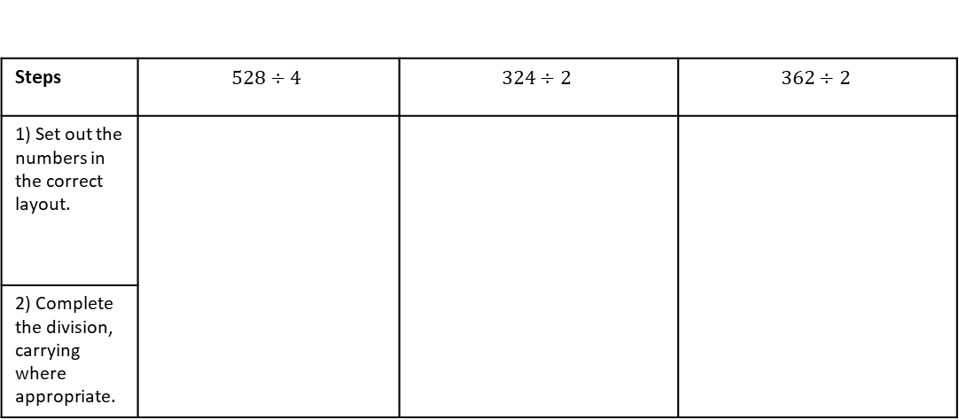
Steps | $$56÷4$$ | $$64÷4$$ | $$96÷4$$
1) Set out the numbers in the correct layout.
2) Complete the division, carrying where appropriate.
Example 37 - I do…
Example 38 – We do…
Example 39 – You do…
Steps | $$528÷4$$ | $$324÷2$$ | $$362÷2$$
1) Set out the numbers in the correct layout.
2) Complete the division, carrying where appropriate.
Example 40 - I do…
Example 41 – We do…
Example 42 – You do…
Steps | $$3232÷2$$ | $$3112÷4$$ | $$3332÷4$$
1) Set out the numbers in the correct layout.
2) Complete the division, carrying where appropriate.
Example 43 - I do…
Example 44 - We do…
Example 45 – You do…

Slide 59

Independent Practice
Question 24
a) $342÷2$ | b) $542÷2$ | c) $524÷4$ | d) $724÷4$
e) $964÷4$ | f) $5644÷4$ | g) $6444÷4$ | h) $9640÷4$
Question 25
a) $3434÷2$ | b) $3636÷2$ | c) $3838÷2$ | d) $3938÷2$
e) $1938÷2$ | f) $1936÷4$ | g) $8936÷4$ | h) $8136÷4$

Slide 60
26. Answer these questions by completing a suitable multiplication.
(a) How many days are there in 17 weeks?
(b) How many hours are there in four days?
(c) Eggs are packed in boxes of six. How many eggs altogether are there in 24 boxes?
(d) Joe bought five boxes of matches. Each box contained 42 matches. How many matches did Joe buy altogether?
27. Answer these questions by completing a suitable division.
(a) How many weeks are there in 91 days?
(b) How long will it take me to save £111, if I save £3 a week?
(c) A rope, 21.5 m long, is cut into five equal pieces. How long is each piece?
28. There are seven columns on one page of a newspaper. In each column there are 172 lines, and in each line there are 50 letters. The newspaper has the equivalent of 20 pages of print, excluding photographs and adverts. Are there more than a million letters in the paper?
29. A tank of water was emptied into casks. Each cask held 81 litres. 71 casks were filled and there were 68 litres left over. How much water was there in the tank to start with?
30. Joy is doing a sponsored walk. She managed to get 18 people to sponsor her, each for 35p per kilometre. She walked a total of 48 km. Did Joy reach her fundraising target of £400?
Notes:
MORE WORDED QUESTION
LONG DIVISON w/example

Slide 61



GCSE PAST PAPER QUESTIONS – Non Calculator paper
Calculator paper
Notes:
Exam questions

Slide 62


GCSE PAST PAPER QUESTIONS – context (NON-CALCULATOR)
Notes:
Exam questions

Slide 63




GCSE PAST PAPER QUESTIONS – context (NON-CALCULATOR)
Notes:
Exam questions

Slide 64




GCSE PAST PAPER QUESTIONS – context (Calculator allowed)
Notes:
Exam questions

Slide 65





Subtopic 5– Order of Operations
LEARNING OUTCOME: To understand and apply correct order of operations
Keywords:
Operation
Index
Power
Root
Objectives:
To correctly apply order of operations with the four operations.
To correctly apply order of operations including indices and brackets.
To insert brackets into calculations to make them correct.
Introduction – In this unit so far, you’ve built strong foundations using the four operations. Now, you’ll apply that knowledge to solve problems using the correct order of operations. The order of operations follows a specific sequence: brackets first, then multiplication and division (from left to right), followed by addition and subtraction (from left to right). Understanding and applying this order is essential for solving multi-step problems accurately.
Definition
-
$$×$$
Characteristics
Operations in mathematics refer to the basic mathematical actions or processes used to perform calculations and solve problems.
+
$$√$$
$$÷$$
Operation
Non - Examples
Examples
In the expression 3 + 4, the operation is addition, which combines 3 and 4 to give a sum of 7.
In the expression 12 ÷ 3, the operation is division, indicating that 12 is shared into 3 equal parts, resulting in 4
23
4.76
Order of operations with $×$ / $÷$ only or $+$ / - only
When calculations have only addition and subtraction OR only multiplication and division, work from left to right.
Example 1 - I do…
Example 2 – We do…
Example 3 – You do…
Steps | Calculate the following | Calculate the following | Calculate the following
1) Determine which operations are in the question 2) Determine the correct order to perform the calculation | $$6×3÷2$$ | $$14−3+5$$ | $$18÷6×2$$
Independent Practice
1. Work out the answers to the following:
Question | Answer
a) $7−4+3$
b) $7+4 −3$
c) $6 −3+4$

Slide 66





d) $2×9÷6$
e) $9÷3×2$
f) $11 −3 −1$
g) $17 −3+7$
h) $16×3÷8$
i) $17 −4+3$
j) $12÷3×7$
Order of operations with $×/÷/+/−$
Example 4 - I do…
Example 5 – We do…
Example 6 – You do…
Steps | Calculate the following | Calculate the following | Calculate the following
1) Determine which operations are in the question. 2) Determine the correct order to perform the calculation. ($×$ and $÷$ before $+$ and $−$). | $$6+3×2$$ | $$7+10 ÷5$$ | $$18−6÷2$$
Independent Practice
2. Work out the answers to the following:
Question | Answer
a) $7+2×3$
b) $9+4×2$
d) $18+4÷2$
e) $20−5×2$
f) $8−2×3$
g) $21−9÷3$
h) $100−40×2$
i) $16÷1−3$
j) $13−7÷1$

Slide 67



Order of operations involving powers and roots
Example 7 - I do…
Example 8 – We do…
Example 9 – You do…
Steps | Calculate the following | Calculate the following | Calculate the following
1) Determine which operations are in the question. 2) Determine the correct order to perform the calculation. (powers and roots, then $×$ and $÷,$ then $+$ and $−$). | $$6−2^{2}$$ $$7 − \sqrt{4}$$ $$\sqrt{19+6}$$ | $$7+3^{3}$$ $$\sqrt{4}+12$$ $$\sqrt[3]{27}+4^{2}$$ | $$8−2^{2}$$ $$15 − \sqrt[3]{27}$$ $$\sqrt{100}−\sqrt{64}$$
Independent Practice
3. Work out the answers to the following:
Question | Answer
$$5−2^{2}$$
$$7+3^{2}$$
$$9^{2}+1$$
$$6^{2}−5^{2}$$
10$−\sqrt{16}$
$$\sqrt{2+14}$$
$${\sqrt{4}+3}^{3}$$
$$2×5−\sqrt{4}$$
$$3^{2}+\sqrt{25}$$
$$\sqrt{19−2×5}$$
$$20−2^{2}×3$$
$$2^{2}×3 −10$$
$${10}^{2}− 3 ×2$$
$$12+\sqrt{4 ×9}$$
$${12}^{2}−9 ×\sqrt{4}$$

Slide 68




Order of operations involving brackets
Example 10 - I do…
Example 11 – We do…
Example 12 – You do…
Steps | Calculate: | Calculate: | Calculate:
1) Determine which operations are in the question 2) Determine the correct order to perform the calculation (brackets, then powers and roots, then $×$ and $÷,$ then $+$ and $−$). | $${\left(4+3\right)}^{2}$$ $$3 ×\left(10−2\right)$$ | $${\left(4−1\right)}^{3}$$ $$20 −3 ×(2+4)$$ | $${\left(7−2\right)}^{2}$$ $$4+ 3 ×(1+5)$$
Independent Practice
4. Work out the answers to the following:
Question | Answer
a) ${\left(1+2\right)}^{2}$
b) ${\left(2+8\right)}^{2}$
c) ${\left(10−7\right)}^{3}$
d) 15 $÷(3 −2)$
e) $35 − \left(9+3\right)$
f) $9×\left(7+4\right)$
g) $\sqrt{(2+14)}$
h) $5 ×\left(2+1\right)+4$
i) $8+\left(5−1\right)×$ 3
j) $7 ×{\left(8÷4\right)}^{2}$
k) $3+9×(7−2)$
l) $(9+4)×(100÷25)$
m) $\sqrt{81}−(9−7)×3$

Slide 69


Inserting Brackets
Example 13 - I do…
Example 14 – We do…
Example 15 – You do…
Steps | Insert brackets to make the following calculation correct | Insert brackets to make the following calculation correct | Insert brackets to make the following calculation correct
1) Determine the current order of operations. 2) Insert brackets to change the order of operations. | $$10×2+6=80$$ | $$5+2×3+1=13$$ | $$5+5÷5=2$$
Independent Practice
5. Insert brackets to make the following calculations correct:
a) $14+1÷3=5$
b) $18÷6+3=2$
c) $20÷4+1=4$
d) $16−12÷4=13$
e) $6+5×2=22$
f) $12−3×2=18$
g) $7×2+3+1=36$
h) $24−4×5−1=3$
i) $16+4×2÷5=8$
j) $2×7+1×3=48$
k) $20+12÷3+1=23$
l) $30−2÷2+5=4$
m) $6 + 4$ $×9 – 9$ $= 0$
n) $9 + 5$ $×$ $4 − 3$ $= 14$

Slide 70





GCSE PAST PAPER QUESTIONS – Non Calculator paper
Notes:
Exam questions

Slide 71



Subtopic 6 – Operations with Negative Numbers
LEARNING OUTCOME: Understand multiply and divide positive and negative numbers.
Objectives:
To add and subtract negative numbers.
To multiply and divide negative numbers.
To solve problems using different rules of arithmetic.
Keywords:
Number lines
Negatives numbers
Definition
Characteristics
Negative numbers are numbers that represent values that are less than zero. They show things like temperatures below zero, debts and losses.
Negative numbers have a negative sign (-) in front of them, telling us they are less than zero. They are smaller than positive numbers. They are like the opposite of positive numbers. Positive numbers are on the right side of zero, and negative numbers are on the left side.
When comparing negative numbers, the one with the smaller distance from zero is considered greater. For example, -3 is greater than -5 because -3 is closer to zero.
Examples
Negative Number
Non - Examples
Temperature: If the temperature drops below zero, like -10 degrees Celsius, it means it's colder than zero degrees.
Debt: When you owe money, the amount is represented by a negative number. For example, if you owe £100, it can be written as -£100.
-3 -10 -0.5 -⅔ -632.456
Positive Numbers: Positive numbers are greater than zero and are not negative.
Zero: Zero is not positive or negative.
5 0 2.5 ⅔ 200 45.67
Addition and Subtraction
Example 1 - I do…
Example 2 - We do…
Calculate
(a) $−4+2$
(b) $−6 −5$
(c) $10+(−4)$
(d) $3−(−1)$
Calculate
(a) $−8+5$
(b) $−6−9$
(c) $1+(−2)$
(d) $−4−(−3)$
Example 3 - You do…
Calculate
(a) $−8+5$
(b) $−6−9$
(c) $1+(−2)$
(d) $−4−(−3)$

Slide 72





1. Complete these calculations.
2. Complete these calculations.
3. Work these out.
4. Evaluate.
5. Write down the calculations shown by these diagrams.

Slide 73






Arithmetic with negative numbers
Multiplication and Division
Example 4 - I do…
Example 5 - We do…
Work out
(a) $7×(−3)$
(b) $−10×(−4)$
(c) $−25÷5$
(d) $−3÷(−1)$
Work out
(a) $−11×4$
(b) $−9×−9$
(c) $−18÷3$
(d) $−16÷(−8)$
Example 6 - You do…
Calculate
(a) $−4 ×5$
(b) $−6×−$6
(c) $−28÷4$
(d) $−4÷(−2)$
6
Write down the answer to each calculation.

Slide 74

7
7. Put these calculations in order from lowest result to highest:
8
8. The rule for converting degrees Celsius (°C) to degrees Fahrenheit (°F) is:
Water freezes at 0 °C and boils at 100 °C. Work out the temperatures in degrees Fahrenheit that water freezes and boils at.
Work out the temperature that is the same in °C and °F.
9
9. CHALLENGE: Absolute zero is the lowest temperature possible. It is approximately -273.5 ºC. Use the formula in question 11 to work out absolute zero in °F. Give your answer to the nearest degree.

Slide 75






Subtopic 7 – Multiplying and dividing decimals
LEARNING OUTCOME: To multiply and divide with decimals.
Objectives:
Keywords:
- Decimal place
- Decimal point
- Dividing
- Multiplying
1. To multiply a decimal number by another decimal number.
2. To divide by a decimal by changing the calculation to division by an integer.
3. To answer worded questions on decimal calculations.
Definition
Characteristics
A decimal is a number that is not whole, as it lies between whole numbers.
Consists of a whole and a fraction part.
The fractional part is written as digits after a point rather than a fraction.
The whole and fraction parts are separated by a point called the decimal point.
Can be terminating or recurring.
Examples
Decimal
Non - Examples
$$38$$
$$1\frac{2}{3}$$
$$\frac{4}{5}$$
1.3 $\sqrt{2}$
10
0.2 123.43 0.278
1.87 12.76578 10000.1 $0.\dot{6}$
4.0000000001 80.987654321 -3.43 $3.\dot{2} 3.\dot{2}746\dot{4}$
240
$$\text{0, −2, 4, 12323, −19}$$
1 × 20 = 20 | so 1 and 20 are both factors of 20
2 × 10 = 20 | so 2 and 10 are both factors of 20
4 × 5 = 20 | so 4 and 5 are both factors of 20
Multiplying decimals by integers
Example 1 - I do…
Example 2 – We do…
Example 3 – You do…
Steps | Evaluate: | Find the value of: | Work out:
1) Multiply each decimal by a power of 10 so that they are integers | 4.3 x 2 = | 0.25 x 3 = | 2.3 x 3 =
2) Multiply the two numbers together
Divide your answer by the powers of 10 you multiplied by originally

Slide 76

Independent Practice
1. Work out.
a) 2.4 × 2
b) 2.4 × 3
c) 1.6 × 2
d) 1.6 × 4
e) 1.6 × 7
f) 2 × 1.6
g) 5 × 0.4
h) 0.21 × 4
i) 0.65 × 7
j) 4.16 × 6
k) 6.34 × 9
l) 7.32 × 8
Multiplying decimals by decimals
Example 4 - I do…
Example 5 – We do…
Example 6 – You do…
Steps | $$2.4×0.5$$ | $$0.2×3.4$$ | $$1.7×0.3$$
Multiply the numbers to make them integers ($×10, 100 or 1000$ etc.)
Carry out the multiplication
Divide the answer by the amount you multiplied each number by

Slide 77



Example 7 – I do…
Example 8 – We do…
Example 9 – You do…
Steps | $$2.4×3.5$$ | $$3.4×7.2$$ | $$1.7×2.3$$
Multiply the numbers to make them integers ($×10, 100 or 1000$ etc.)
Carry out the multiplication
Divide the answer by the amount you multiplied each number by
Example 10 – I do…
Example 11 – We do…
Example 12 – You do…
Steps | $$21.4×3.5$$ | $$3.24×7.2$$ | $$1.17×2.3$$
Multiply the numbers to make them integers ($×10, 100 or 1000$ etc.)
Carry out the multiplication
Divide the answer by the amount you multiplied each number by
Independent Practice
Question 2
a) $3.1×0.5$ | b) $6.3×0.3$ | c) $5.4×0.7$

Slide 78

Independent Practice
Question 2 continued
d) $9.2×0.6$ | e) $4.8×0.9$ | f) $2.4×3.2$
g) $9.1×1.3$ | h) $5.5×7.7$ | i) $1.7×4.3$
j) $9.4×4.9$ | k) $0.13×0.7$ | l) $0.48×0.3$
m) $0.54×0.9$ | n) $0.18×0.17$ | o) $8.3×0.37$
p) $3.5×0.74$ | q) $0.94×0.02$ | r) $0.38×0.06$

Slide 79

Independent Practice
Question 4 | Question 5
Mr.Jenkins is building a fence for his garden. The fence costs £12.60 per metre to build. The fence is 5.3 metres long. Work out the total cost of building the fence. | Joanne is baking some cupcakes for a party. The recipe states she needs 84.5g sugar to make 6 cupcakes. She wants to multiply each ingredient by 4.5 to make 27 cupcakes. How much sugar does she need?
Question 6 | Question 7
Here are the prices of some fruit in a shop. Find the total cost of 1.2kg of apples, 3.5kg of oranges and 1.9kg of bananas. | The area of a field is 94.8m²? Grass seed costs £2.50 per m². How much is the total cost?
£0.90
£1.70
£1.40

Slide 80






Dividing decimals with different number of decimal places.
Example 13 - I do…
Example 14 – We do…
Example 15 – You do…
Steps | Work out: | Evaluate: | What is:
Multiply each decimal by THE SAME power of 10 so that they are both integers
Divide the two numbers using bus stop division
This is your final answer because it is in proportion to the original question
4.2 $÷$ 0.02
12 $÷$ 0.3
1.2 $÷$ 0.04
0.75 $÷$ 0.5
25.2 $÷$ 0.03
1.47 $÷$ 0.07
Independent Practice
8. Evaluate each of the following.
a) 50 ÷ 0.2
b) 5 ÷ 0.2
c) 5 ÷ 0.1
d) 0.1 ÷ 5
e) 0.1 ÷ 0.05
f) 0.2 ÷ 0.05
g) 84.7 ÷ 0.07
h) 58.2 ÷ 0.06
Notes:
I do – examples filling in

Slide 81
9. Work out.
a) 12.4 ÷ 2
b) 1.24 ÷ 0.2
c) 0.15 ÷ 0.5
d) 0.72 ÷ 0.2
e) 0.48 ÷ 0.3
f) 0.048 ÷ 0.2
g) 0.095 ÷ 0.5
h) 0.072 ÷ 0. 6
10. A carpenter needs some wood cut into 0.7-metre lengths.
How many 0.7-metre lengths can she cut from nine 2.4-metre lengths?
11. You are given that 6.96 ÷ 0.24 = 29.
Use this information to work out the answers to these divisions.
(a) 69.6 ÷ 2.4 (b) 6.96 ÷ 0.29 (c) 6.96 ÷ 58 (d) 2.32 ÷ 29
12. Doris buys a big bag of safety pins. The bag weighs 180 g. Each safety pin weighs 0.6 g. How many safety pins are in the bag?

Slide 82




Subtopic 8 – Using a Calculator
LEARNING OUTCOME: Understand how to carry out basic skills on a calculator
Objectives:
Keywords:
function key
shift key
Use some of the important keys when working on a calculator.
Look at some key functions
Use a calculator to solve questions.
Notes: Use this space to note down any useful buttons your teacher tells you
Example 1 - I do…
Example 2 - We do…
Example 3 – You do…
1) Press the fraction button | Write $\frac{1}{5}$ as a decimal. | Write $\frac{7}{10}$ as a decimal. | Write $\frac{5}{8}$ as a decimal.
2) Insert the digits into the correct places
3) Press “=” then change the answer to decimal.
Example 4 - I do…
Example 5 - We do…
Example 6 – You do…
1) Press ‘shift’ then the fraction button | Write $4\frac{7}{11}$ as a decimal and as an improper fraction. | Evaluate $9\frac{2}{7}+11\frac{3}{5}$ Give your answer as a decimal and a fraction | Evaluate $3\frac{9}{14}−2\frac{1}{5}$ Give your answer as a decimal and a fraction
2) Insert the digits into the correct places
3) Press “=” then change the answer to decimal.

Slide 83



Notes:
Example 7 - I do…
Example 8 - We do…
Example 9 – You do…
1) Press the square root button | Find $\sqrt{49}$ | Find $\sqrt{81}$ | Find $\sqrt{144}$
2) Insert the digits into the correct places
3) Press “=”.
Notes:
Example 10- I do…
Example 11 - We do…
Example 12 – You do…
1) Press the “indices” button | Find ${14}^{2}$ | Find $9^{3}$ | Find ${16}^{2}$
2) Insert the digits into the correct places
3) Press “=”.
Notes:
Example 13 - I do…
Example 14 - We do…
Example 15 – You do…
1) Press ‘shift’ then the ‘root’ button | Find $\sqrt[3]{27}$ | Find $\sqrt[4]{4096}$ | Find $\sqrt[5]{1024}$
2) Insert the digits into the correct places
3) Press “=”.

Slide 84



Notes:
Example 16 - I do…
Example 17 - We do…
Example 18 – You do…
1) Input the question exactly as it looks | $$\left(4.2+3.2\right) × 74$$ | $$\left(4.5+3.2\right) × 74$$ | $$\left(4.5−3.2\right) × 74$$
2) Press “=“.
Notes:
Example 19 - I do…
Example 20 - We do…
Example 21 – You do…
Input the question exactly as it looks Use the arrows to navigate to different parts of the fraction Press “=“. | $$\frac{{22}^{2}}{ \sqrt{9.4−5.3}}$$ | $$\frac{18.2+7.4}{\sqrt{9.22} −{1.2}^{2}}$$ | $$\frac{\sqrt{17.8+{9.93}^{2}}}{1.25−5.9}$$
Notes:
Example 22 - I do…
Example 23 - We do…
Example 24 – You do…
1) Input the question exactly as it looks | $$π×5^{2}$$ | $$12cos⁡(45)$$ | $$\frac{12}{sin⁡(35)}$$
2) Press “=“.

Slide 85

Independent Practice
Question 1 Use a calculator to work out each of the following. Write down all of the figures on your display.
a) $\sqrt{1.69}$ | b) ${1.25}^{2}$ | c) $\sqrt{1.96×2.25}$
d) ${1.3}^{2}+{1.4}^{2}$ | e) ${3.1}^{4}$ | f) $\sqrt[6]{84}$
d) ${1.3}^{2}+{1.4}^{2}$ | e) $\frac{\sqrt{8.6}}{2}$ | f) $\sqrt{\frac{8.6}{2}}$
g) $π+5$ | h) $4\frac{4}{17}$ | i) $5\frac{2}{21}−3\frac{1}{15}$
j) $\left(8.2−1.2\right) × 31$ | k) $\left(8.2−{1.2}^{2}\right)× 31$ | l) $\frac{25.4+{1.9}^{3}}{6.5}$

Slide 86

Independent Practice
Question 1 Use a calculator to work out each of the following. Write down all of the figures on your display.
m) $\frac{\sqrt{12.36−5.12}}{{2.97}^{2}}$ | n) $\sqrt{\frac{25.1−3.87}{5.23+2.04}}$ |  | o) $\sqrt[3]{7^{2}+1}$
p) $\sqrt[3]{π^{5}}$ | q) $\sqrt{{12}^{2}+{15}^{2}−54cos⁡(80)}$ |  | r) ${(3.15−0.28)}^{2}−4.076$
s) $\frac{\sin\left(25\right)+cos⁡(40)}{\cos\left(25\right)−sin⁡(40)}$ | t) $\frac{\sqrt{90}−\sqrt[3]{10}}{{({1.1}^{5}+\sqrt{3})}^{2}}$ |  | u) $\sqrt{\frac{{3.5}^{2}}{6.3−\frac{47}{63}}}$
v) Choose values for a and b and use your calculator to test whether or not these statements are true. i) (a − b)(a + b) = a² − b²
ii) (a + b)² = a² − 2ab + b²

Slide 87

GCSE Past Paper Questions

Slide 88


Slide 89


Slide 90


Slide 91


